Slide 1
Input Layer
LeakyReLU
Tanh
…
…
…
…
128
256
512
1024

Slide 2
Input Layer
Hidden Layer
…
…
…
…
128
256
512
1024

Slide 3
Generator
128
256
512
1024
…
…
…
…
LeakyReLU
Tanh

Slide 4
Discriminator
512
256
256
1
…
…
…
LeakyReLU
sigmoid

Slide 5
Generator
128
256
512
1024
…
…
…
…
LeakyReLU
Tanh

Slide 7
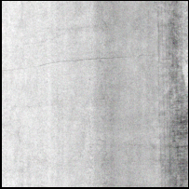

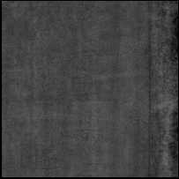
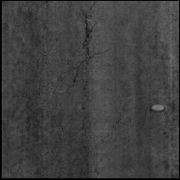
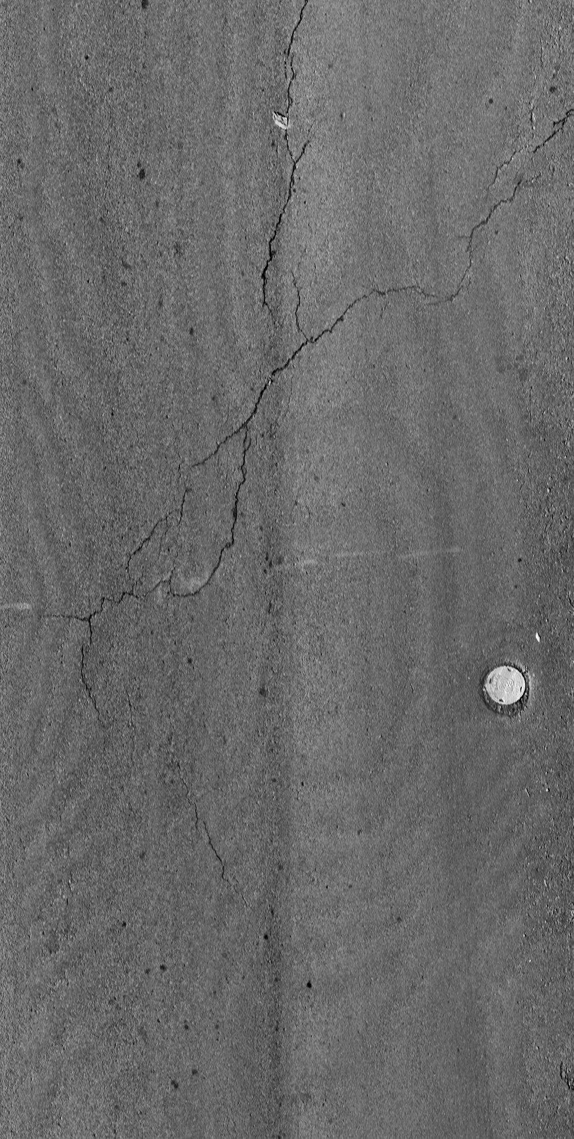
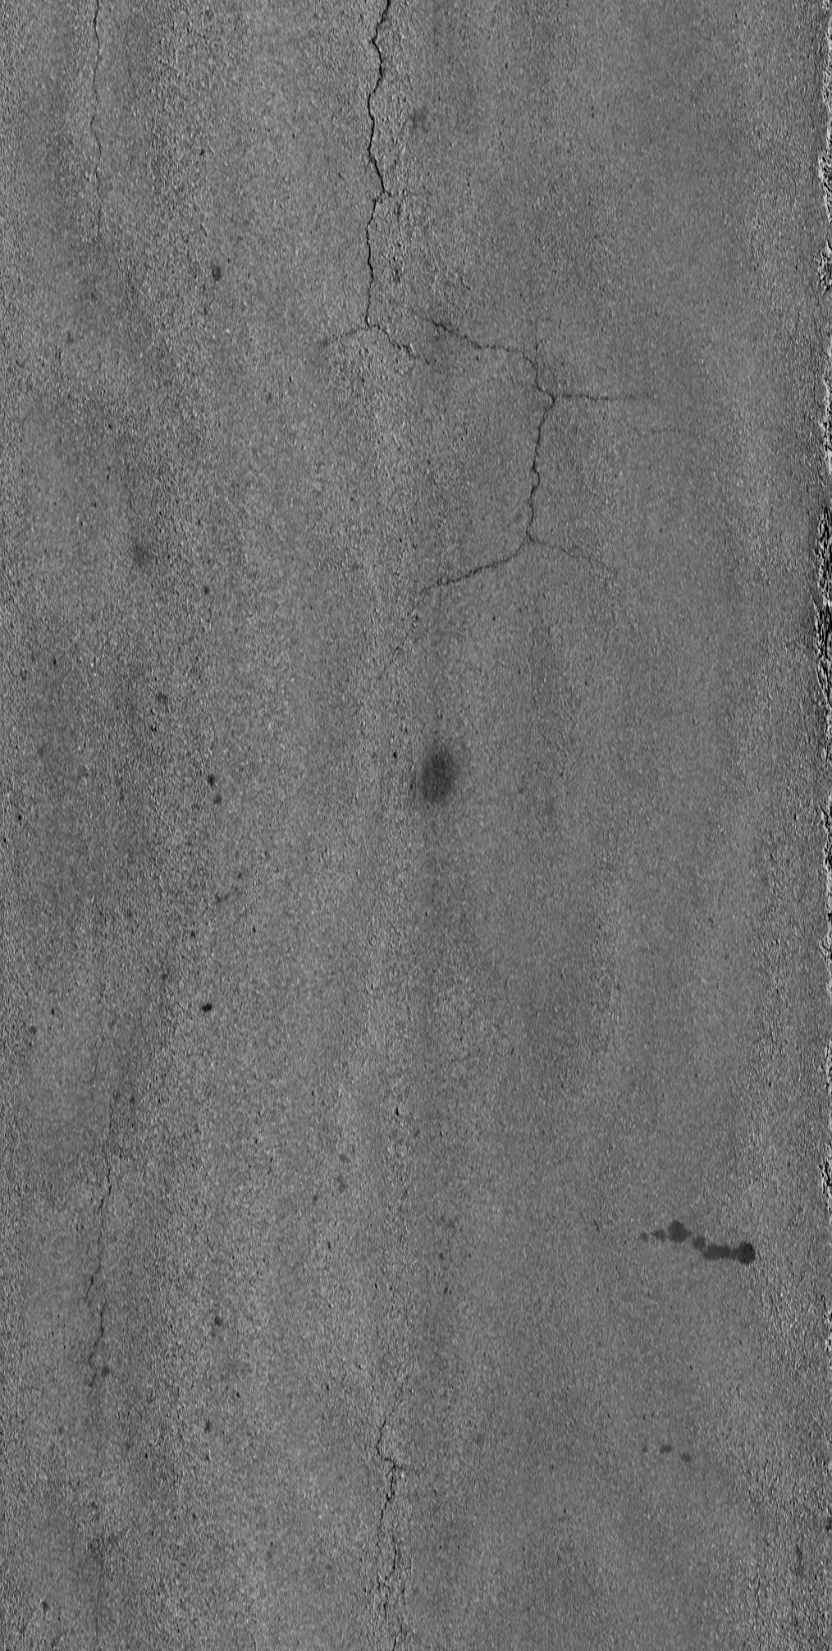
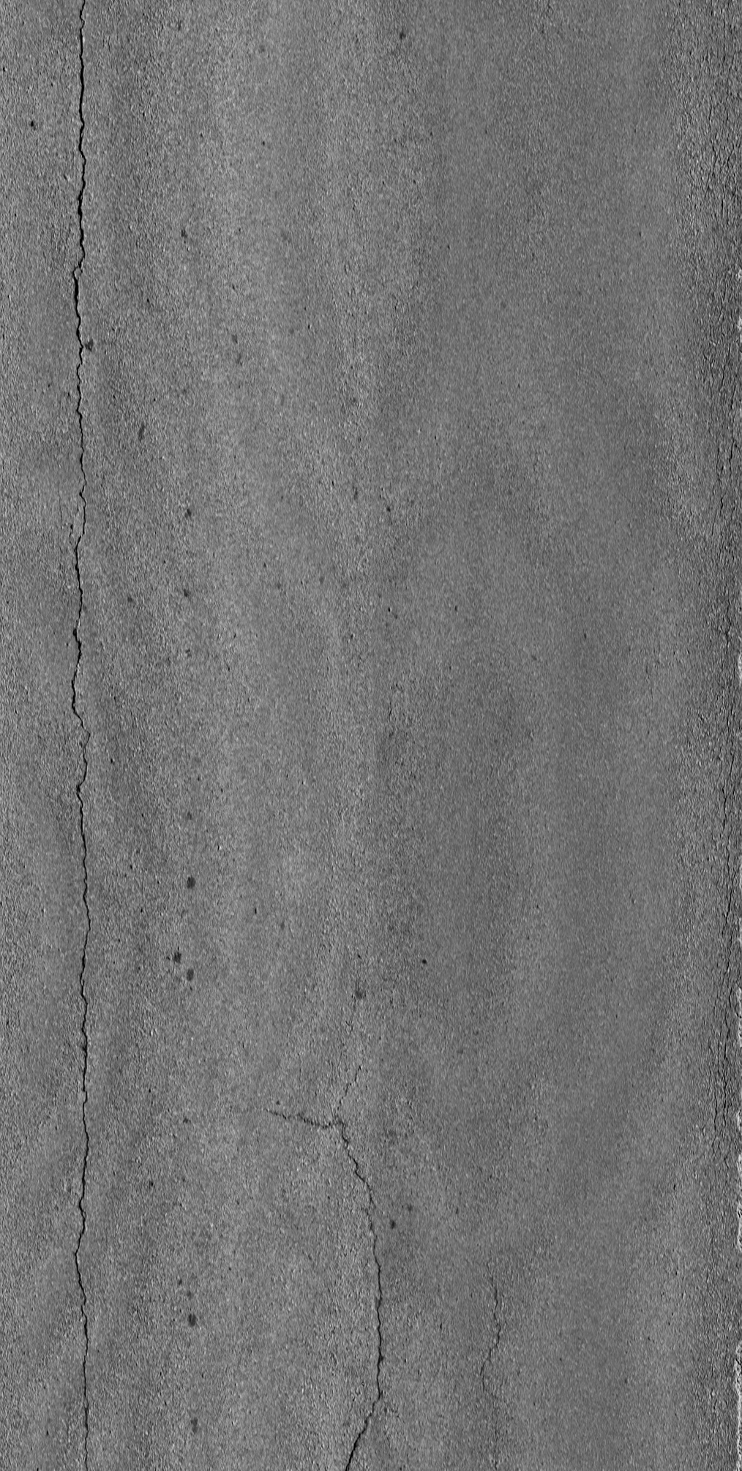
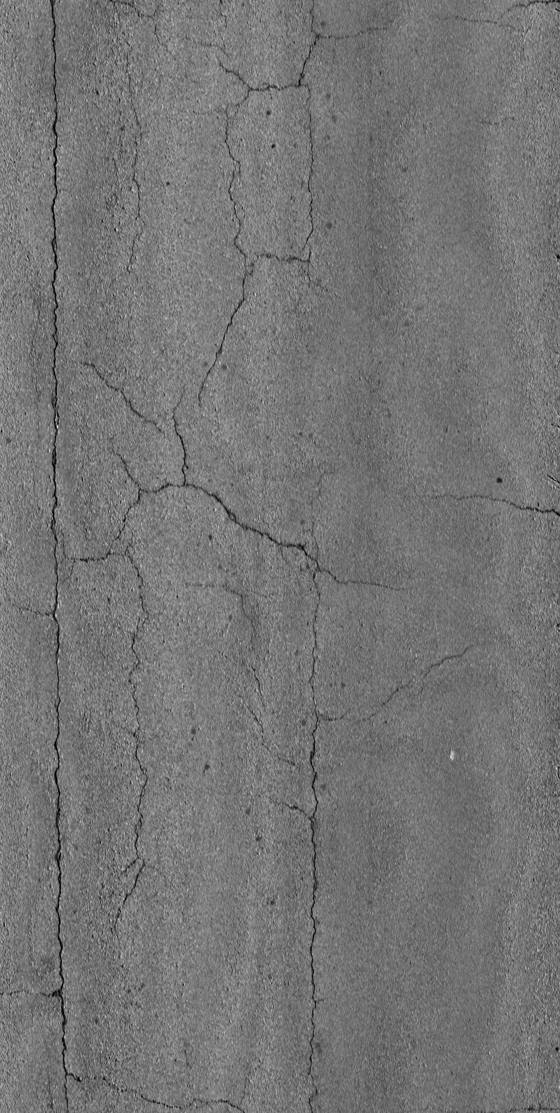
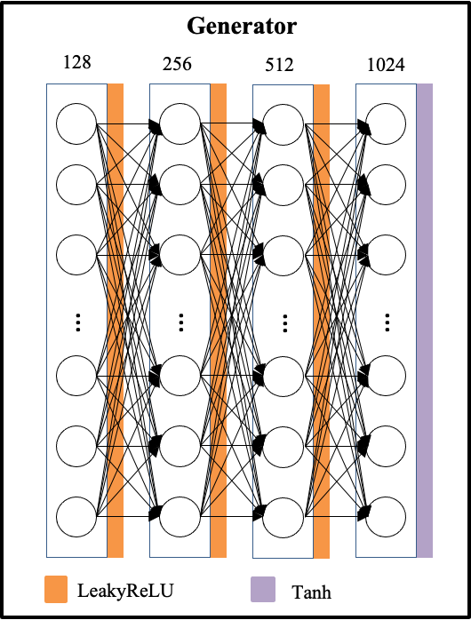
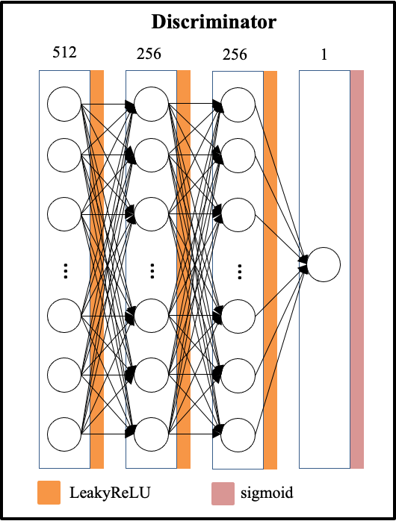
Generator
Discriminator
128
512
LeakyReLU
LeakyReLU
256
256
LeakyReLU
LeakyReLU
512
256
LeakyReLU
LeakyReLU
1024
1
Tanh
Sigmoid

Slide 8
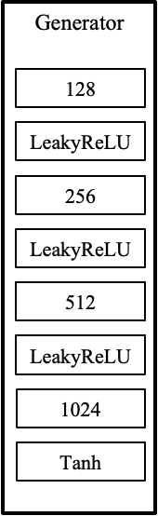
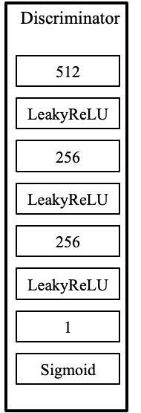
Random input vector
Update model
Fake images
Real/fake
Real images
Update model

Slide 9
Random input vector
Fake images
Update
model
Real images
Real/fake
Update model

Slide 10
Random input vector
Generator
Update model
Fake images
Discriminator
Real/fake
Real images
Update model

Slide 11
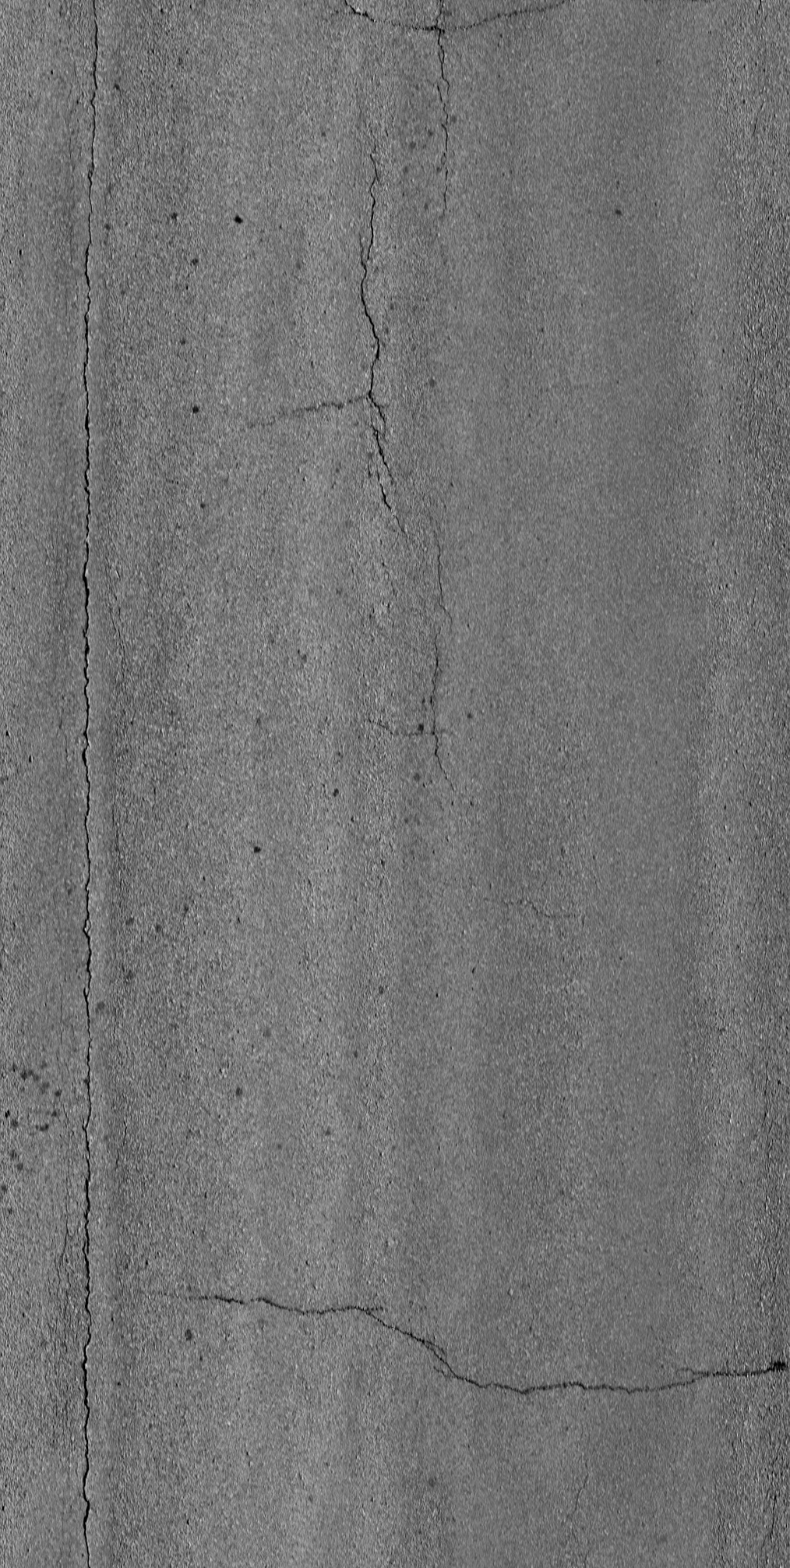
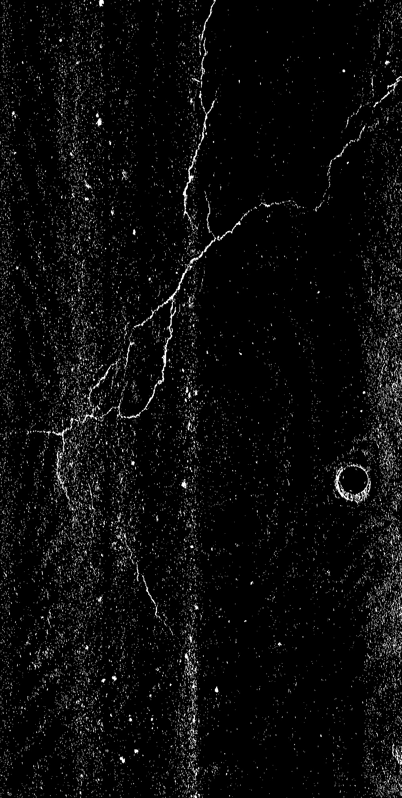
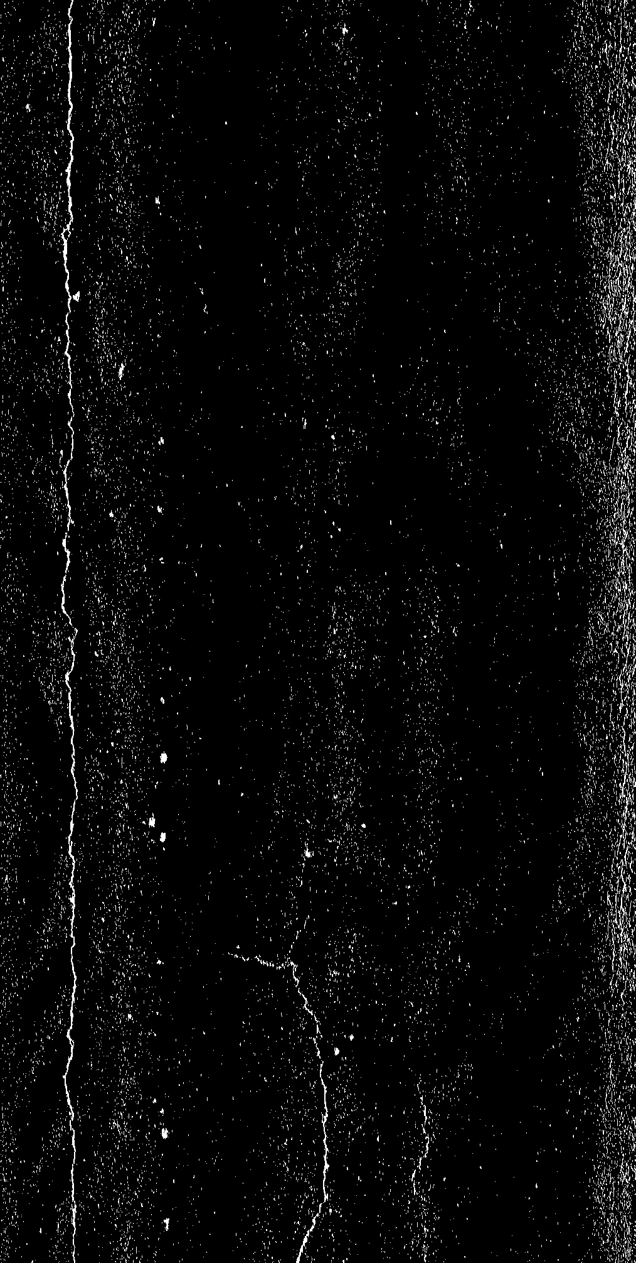
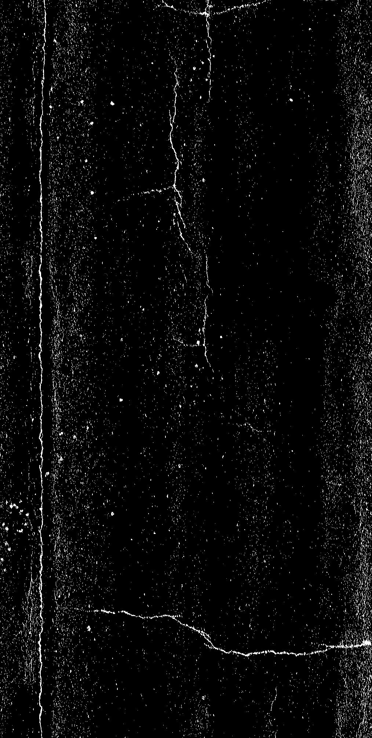
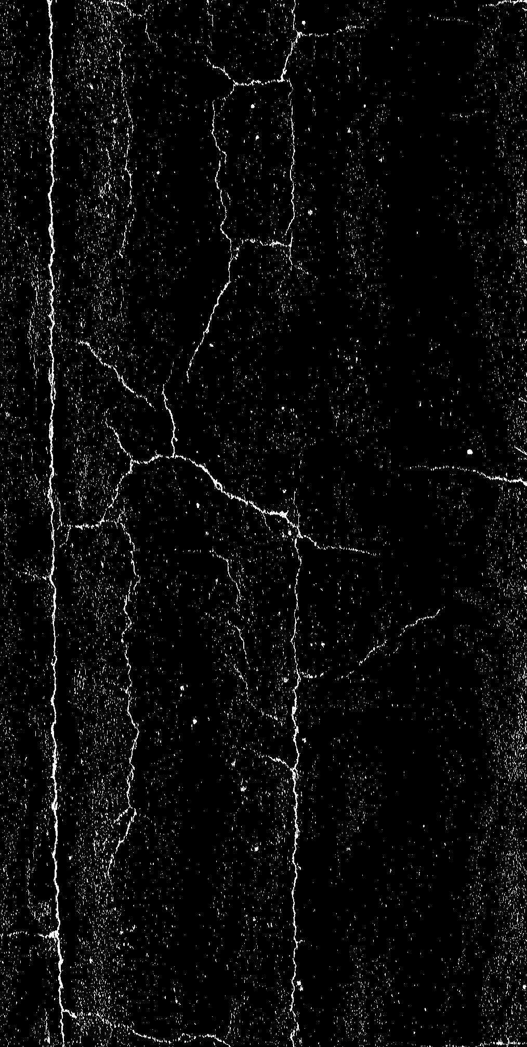
1
6
7
8

Slide 12
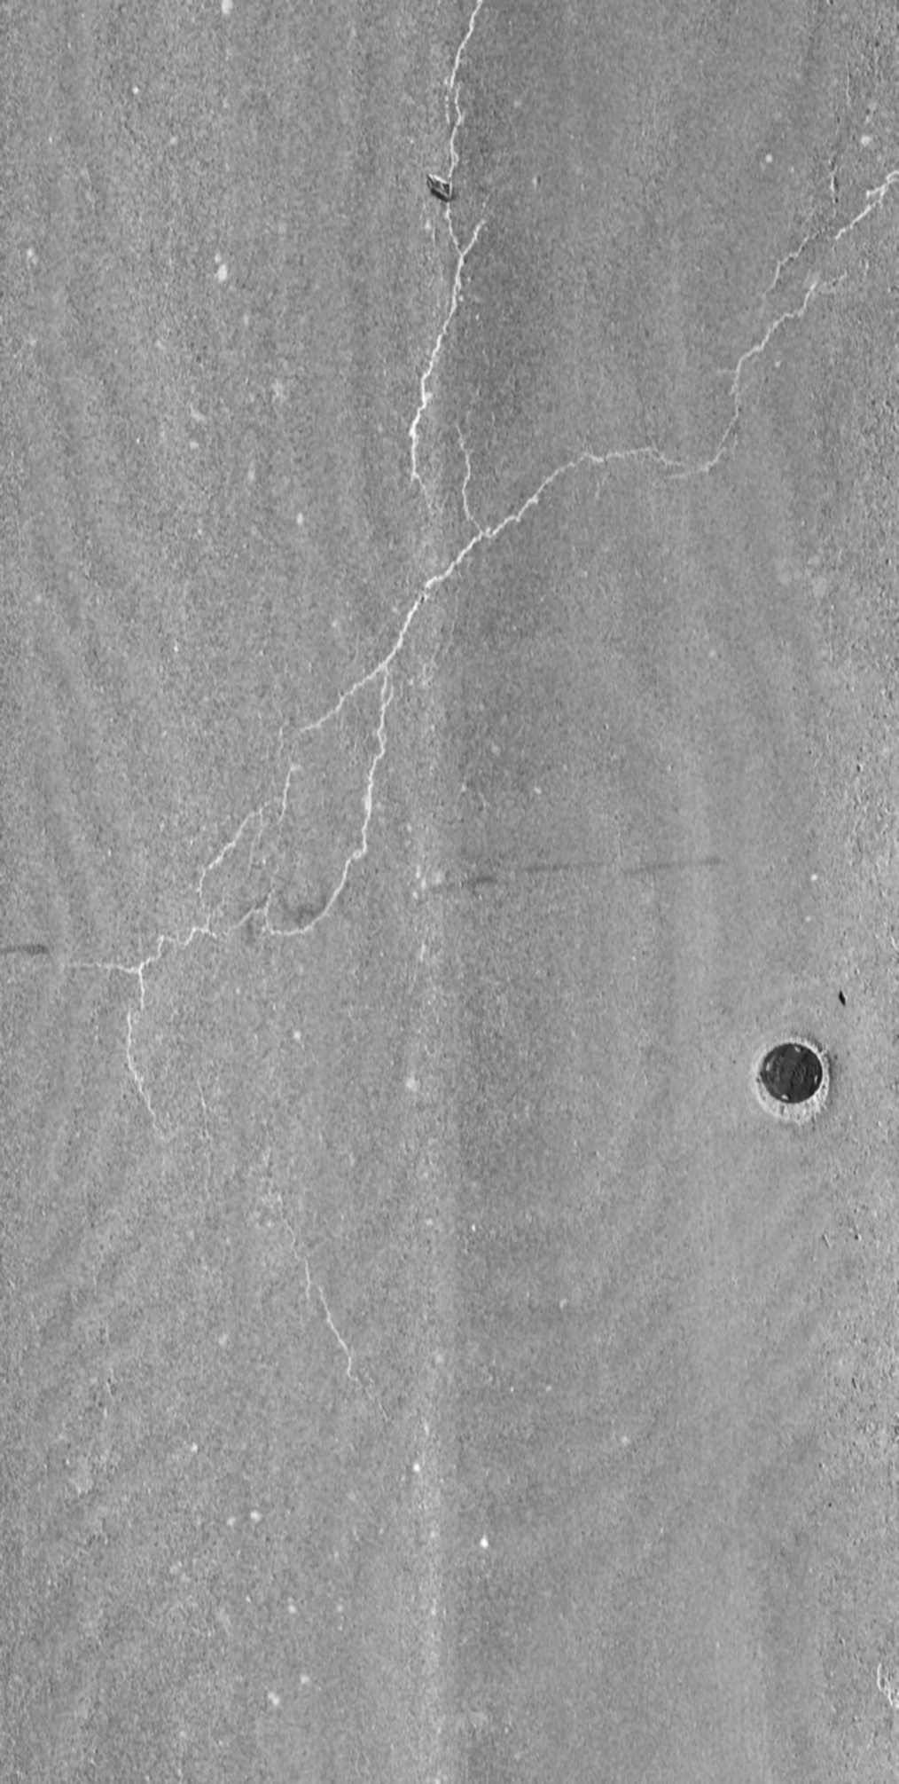
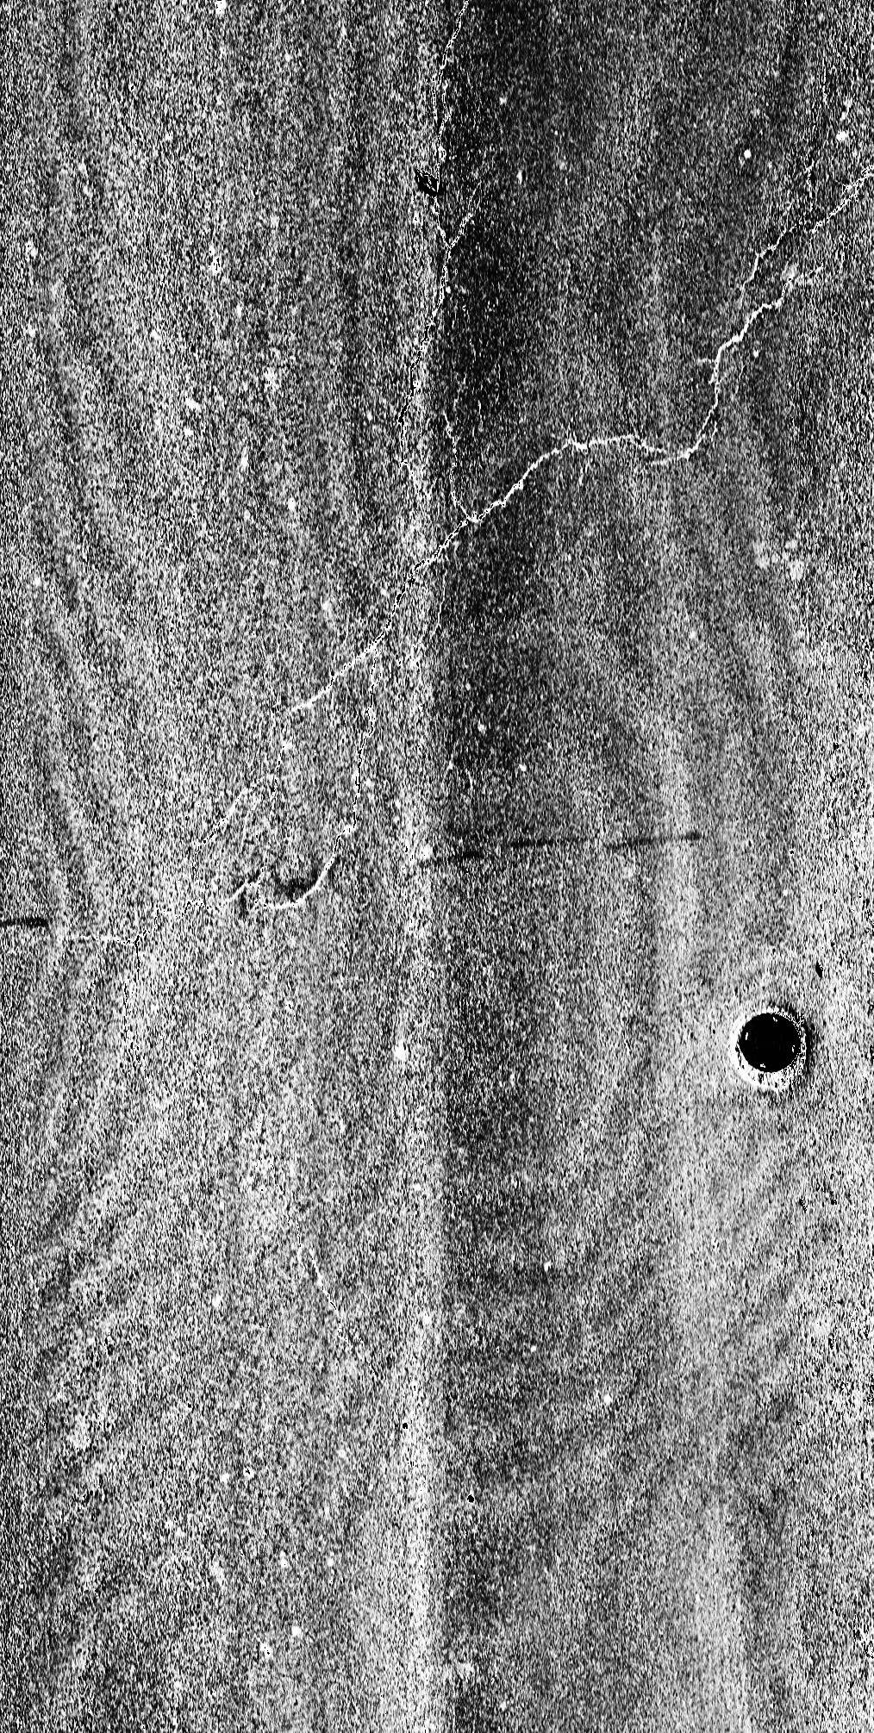
(a)
(b)
(c)
(d)

Slide 13
Pavement images
GAN
Annotation
Training
Validation
Yolov5
Testing

Slide 14
Pavement images
Training
Yolov5
Testing
GAN
Annotation
Validation

Slide 15
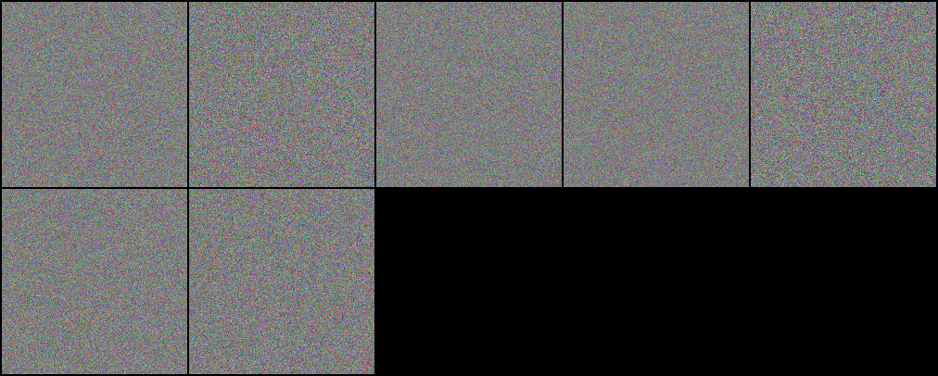
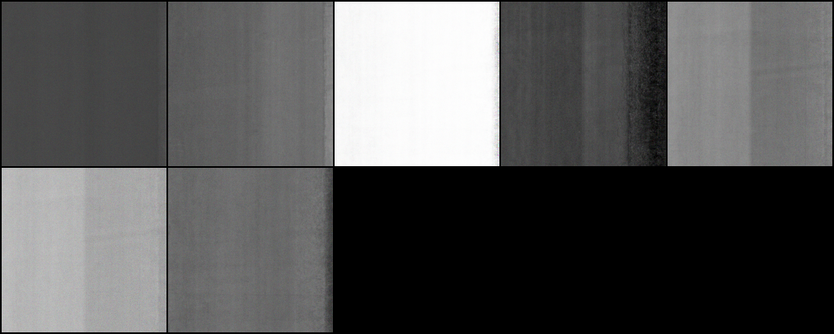
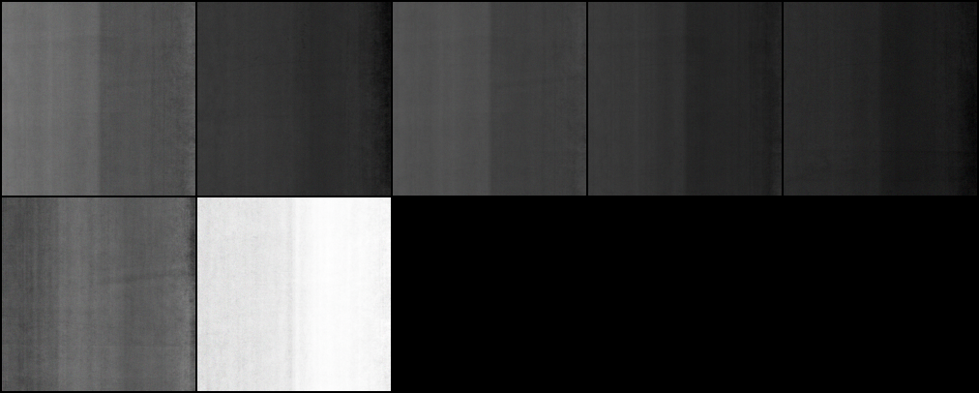
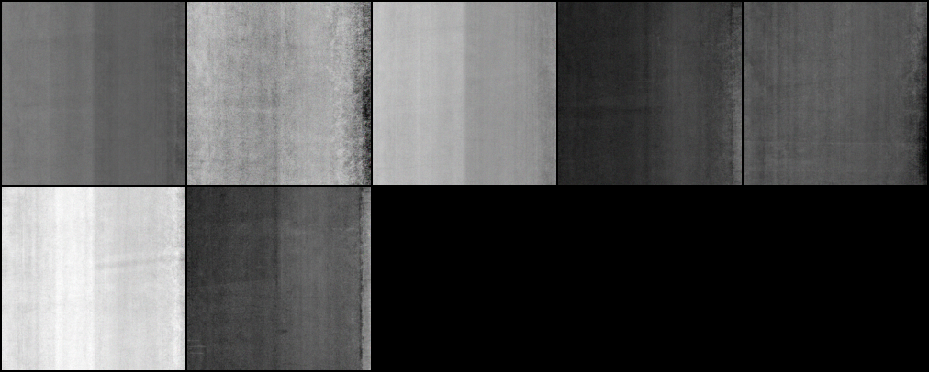
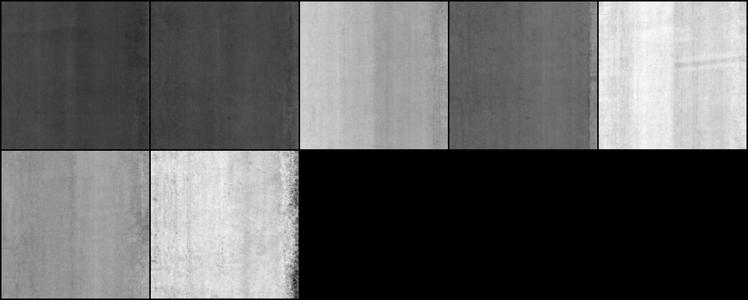
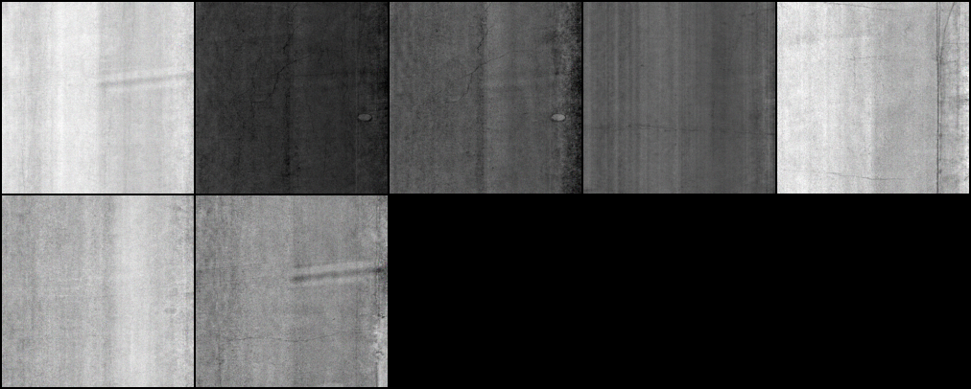
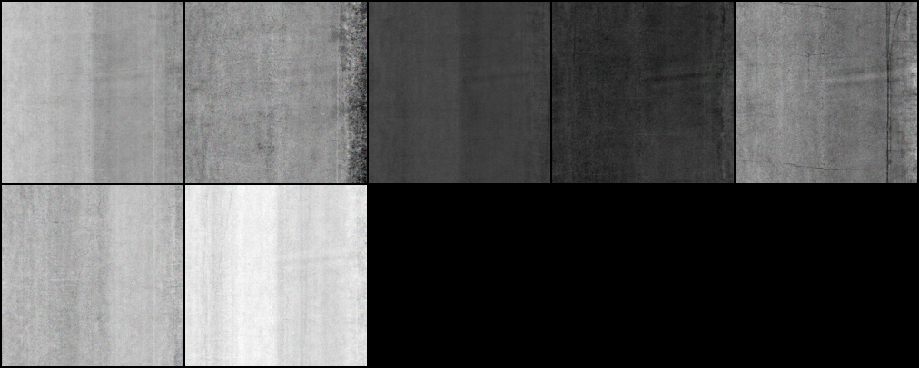
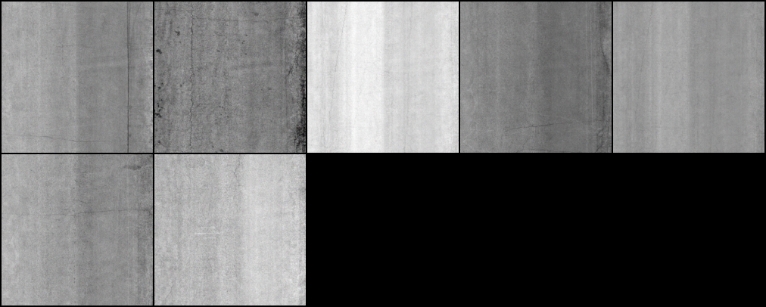
0
20000
40000
60000
80000
100000
120000
140000

